Slide 1
iNaturalist training and the City Nature Challenge 2023
How to run a species recording event

Slide 2
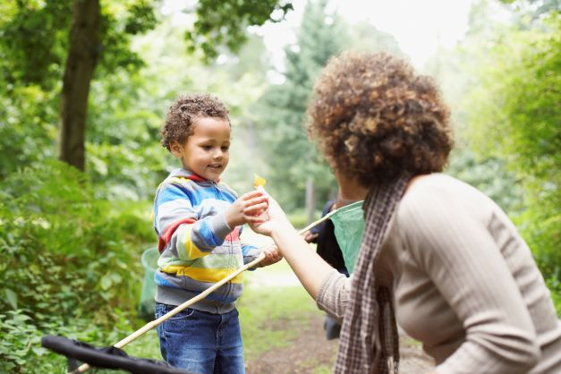
Species recording and citizen science
By recording species information we can help safeguard and protect sites and habitats
Getting the community involved in recording means that more people will appreciate the nature around them and understand the importance of protecting these spaces

Slide 3
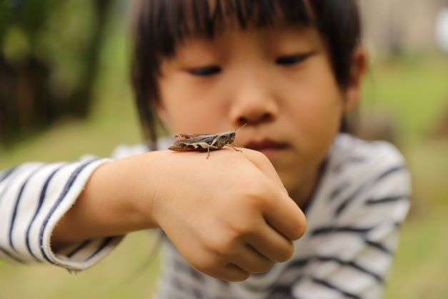
Tell us about your events
We’d love to help publicise your events!
Let’s get as many people involved as possible
It’s an opportunity to raise the profile of the friends group
Email laura@cprelondon.org.uk

Slide 4
Over 450 cities worldwide taking part in 2023!
Notes:
City Nature Challenge has been running since 2016 and is overall organised by the Natural History Museum of Los Angeles County and California Academy of Sciences. It was initially just between two cities, SF and LA, and over the years the number of cities involved worldwide has grown. London has been involved since 2018 and the Challenge in London is led by the Natural History Museum’s Community Science team.
CNC is a friendly competition across cities worldwide to see which city can involve the most people in recording the most wildlife. But, more importantly, it’s about bringing people together, getting them involved in citizen science, and helping connect them with nature.
CNC can be done alone, with a community group, or with friends or family.

Slide 5
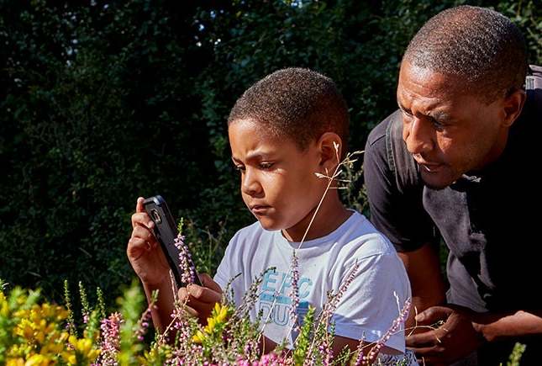
Photo credit: Natural History Museum
Notes:
City Nature Challenge uses the website and phone App iNaturalist to upload photos of the nature you find over the Challenge’s four day period. iNaturalist helps to identify and record what you find, and Cassandra from The Conservation Volunteers (TCV) Haringey will soon be explaining how to use iNaturalist in detail.
Outside of CNC, at any time of year, you can use iNaturalist to identify and record wlife in your own time, or at any of your community events.

Slide 6
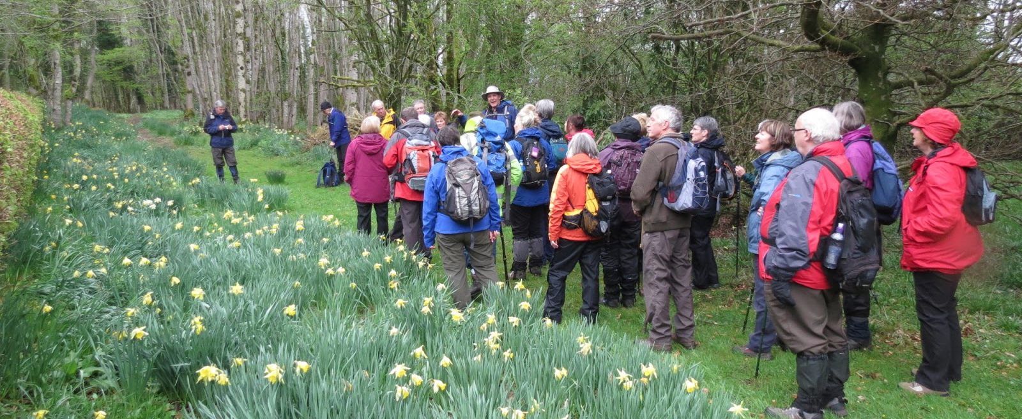
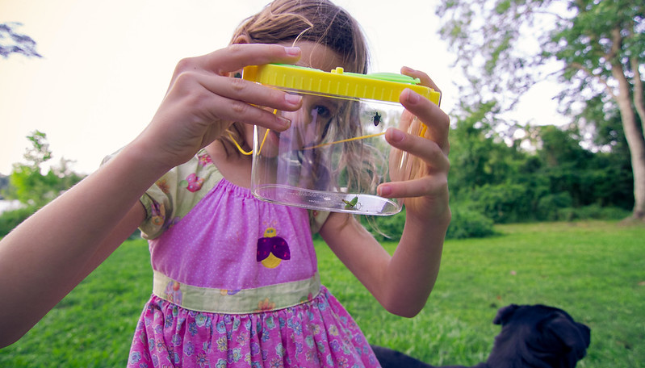
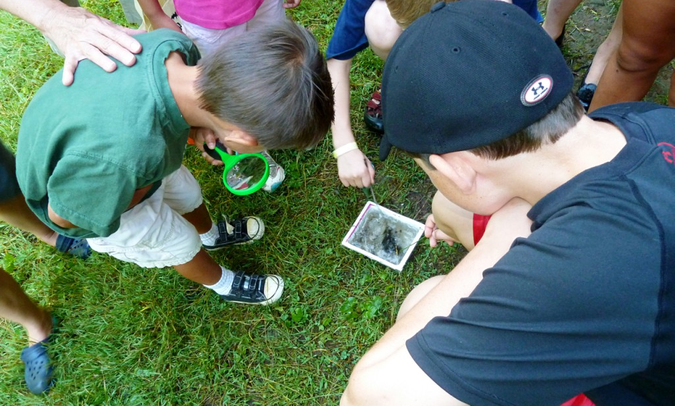
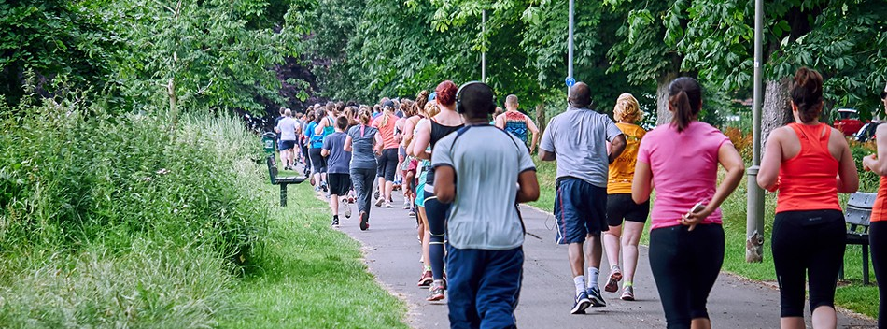
Copyright: The Glebe Blog
Copyright: Kelly Verdeck; Flickr
Copyright: Marcia Tate
Copyright: BrucieBaby: Parkrun
Notes:
There are lots of ways to bring CNC and iNaturalist into community activities – you can even integrate it into events you already have planned. Some ideas for events: mini beast hunts, runs, guided tours, wildlife surveys, moth traps, litter picking. Just remember, it doesn’t mean people have to have their eyes glued to their phones to be involved in CNC, even if they only record one thing during an event it’s something! Most importantly, people got outdoors and hopefully had fun!
Also, people don’t have to have a smart phone to be part of the event – they can even look at the phone of the event leader or other participants there if those participants are happy with it.

Slide 7
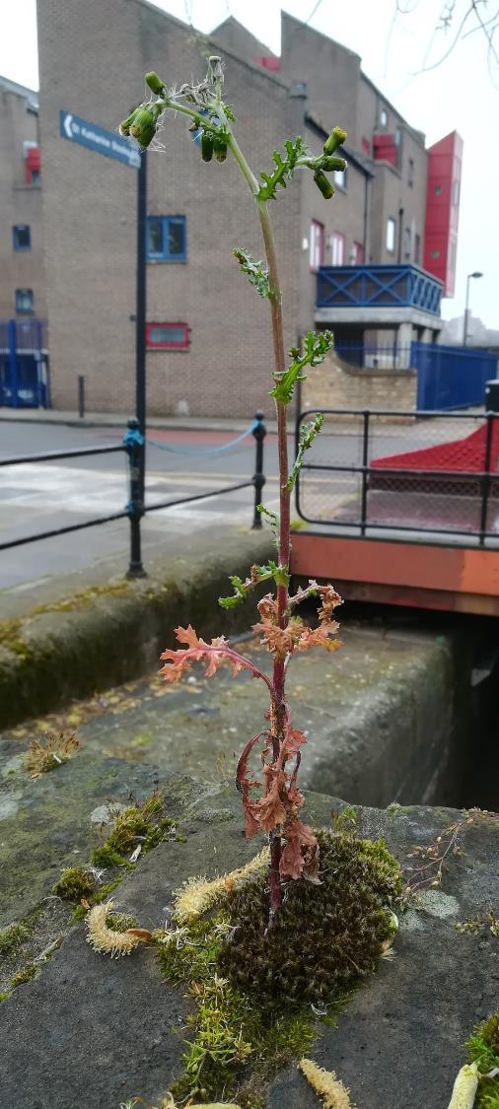
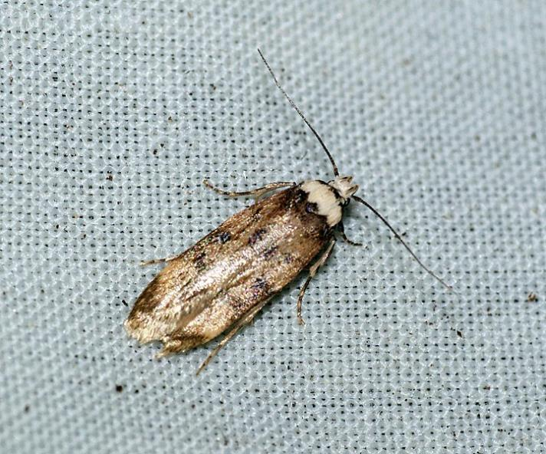
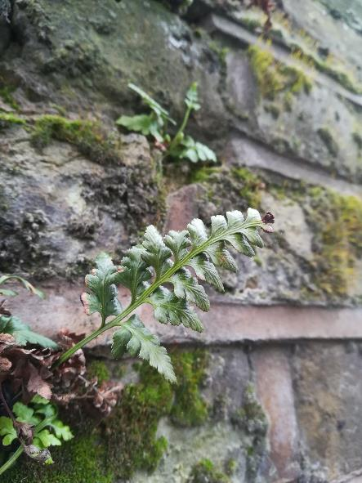
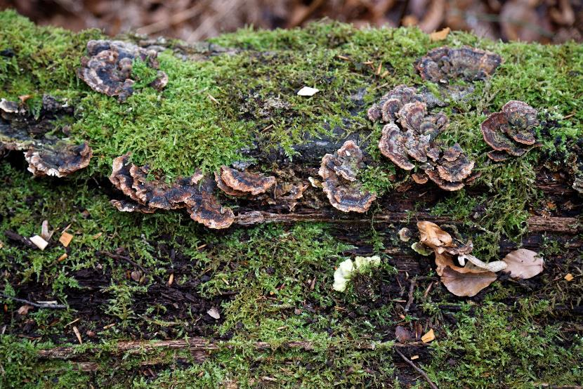
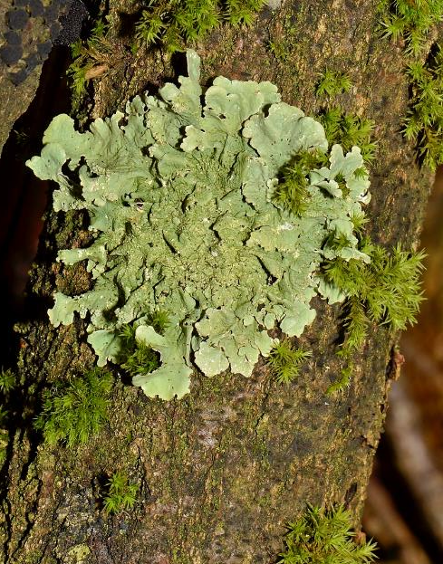
Notes:
As I’m sure most, if not all, of you already know, nature can be found in unlikely places, and people don’t need to be surrounded by an abundance of biodiversity to take part in CNC. For example, it can be found at home, from the window, on a housing estate, and in a very urban local park. Even down a street people can record nature they find between paving slabs and growing on walls.
CNC can also be a great opportunity for people to discover parks they’ve never visited before, and to discover Friends group who might be delivering CNC events!

Slide 8
Helpful links
City Nature Challenge - https://citynaturechallenge.org
City Nature Challenge 2023 London - https://www.nhm.ac.uk/take-part/citizen-science/bioblitz/city-nature-challenge.html
iNaturalist - https://www.inaturalist.org/
How to use iNaturalist video turorials https://www.inaturalist.org/pages/video+tutorials
How to use iNaturalist text guide - https://www.bnhc.org.uk/wp-content/uploads/2022/12/How-to-use-iNaturalist-.docx.pdf
UK leader board of cities 2023 - https://www.inaturalist.org/projects/city-nature-challenge-2023-uk-leaderboard

